Slide 1
Business Process Modelling and Enterprise Architecture
& Advanced Information System Development
Agile Software Development in Practice
Dilshan
Jayatilake

Slide 2
Session Plan
By the end of this session, you should be able to:
  Explain the key principles of Agile and Scrum.
  Describe the purpose of Scrum roles, events and artefacts.
  Apply product backlogs, sprint backlogs and sprint goals to your group project.
  Use standups and sprint reviews to evidence progress and contribution.
  Explain how Scrum supports planning, risk management, feedback and continuous improvement.

Slide 3
Agile Scrum For Software Engineering Projects
Agile is an approach to software development that accepts uncertainty and change.
Scrum is one Agile framework used to organise work into short, focused cycles.
In this project, Scrum will help your group plan, deliver, review and improve the system incrementally.
The aim is not only to complete the assessment, but to work in a way that reflects professional software development practice.

Slide 4
Why Agile Emerged
Traditional software development often assumed that requirements could be fully understood at the start.
In many real projects, requirements change as users, developers and stakeholders learn more.
Agile emerged as a response to long development cycles, late feedback and poor alignment with user needs.
Agile methods prioritise working software, collaboration, adaptation and frequent feedback.

Slide 5
Agile Values
Agile projects usually involve:
  Frequent delivery of usable increments.
  Regular feedback from stakeholders.
  Continuous reflection and improvement.
  Close collaboration within the team.
  Flexibility when priorities or understanding change.
  Technical quality through testing, review and integration.
These principles should be visible in how your group manages the assessment project.

Slide 6
What Scrum Is
Scrum is a lightweight framework for managing complex work.
It does not prescribe every technical method.
Instead, it provides roles, events and artefacts that help teams inspect progress and adapt their plans.
Scrum works well when the team cannot predict everything at the start and must learn through delivery.

Slide 7
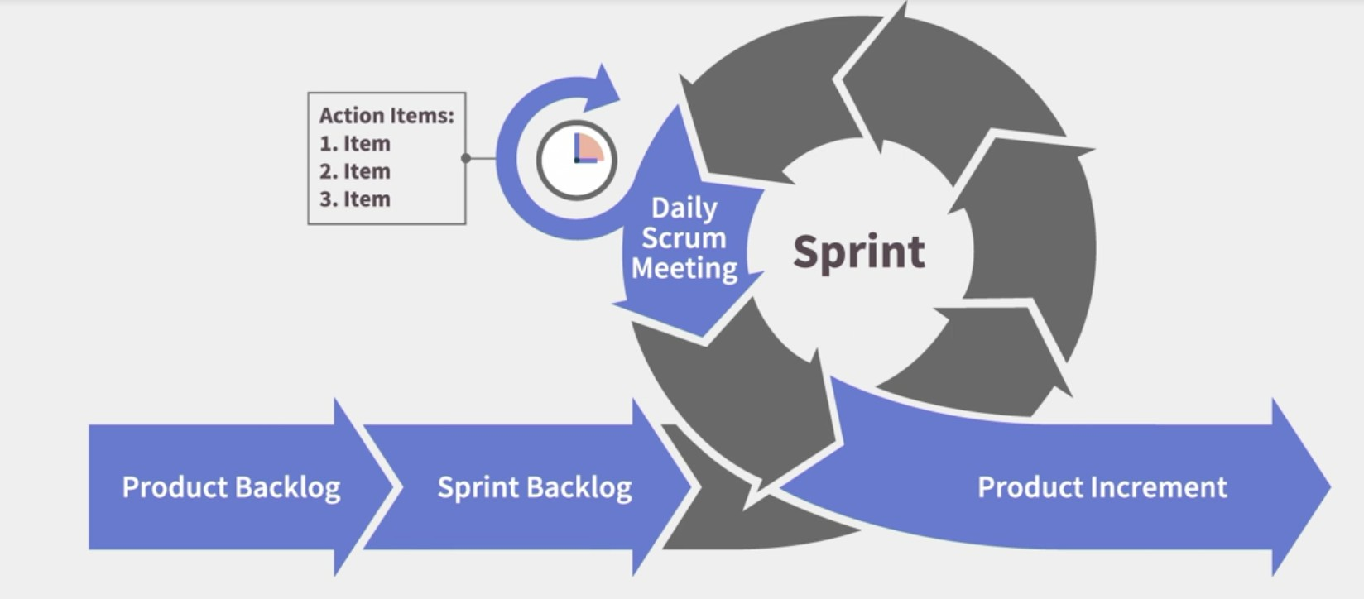
Empiricism In Scrum
Scrum is based on empiricism. This means decisions are made using evidence from what has actually happened.
Scrum depends on three pillars:
  Transparency: work, progress and problems are visible.
  Inspection: the team regularly checks progress and quality.
  Adaptation: the team changes its plan when evidence shows that change is needed.
Your task board, repository, sprint reviews and testing records all support these three pillars.

Slide 8
Scrum Theory And Your Assessment
Transparency means tutors and team members can see who is doing what.
Inspection happens during standups, sprint reviews and feedback sessions.
Adaptation happens when the team updates the backlog, changes priorities or improves the second release.
The assessment rewards evidence that the group has planned, delivered and improved the project over time.

Slide 9
Scrum Roles
Scrum normally includes:
  Product Owner: represents priorities and value.
  Scrum Master: supports the process and removes obstacles.
  Developers: produce the project increment.
In your assessment, these roles are adapted. The tutor acts partly as the client or reviewer, and the group acts as the development team. The group may nominate a coordinator, but responsibility remains shared.

Slide 10
The Development Team
The development team is responsible for turning backlog items into a working increment.
In your project, the team includes all group members.
Each student must contribute to planning, modelling, development, testing, review and evidence.
A team cannot rely on one person to understand the whole project.
Every member must be able to explain their own contribution and the current state of the work.

Slide 11
First Owner And Second Owner
Each task must have a first owner and a second owner.
The first owner leads the task and is responsible for delivery.
The second owner stays informed and can continue the work if needed.
This supports continuity, reduces delivery risk and avoids single points of failure.
This also reflects professional practice, where teams manage risk through shared understanding.

Slide 12
Scrum Artefacts
Scrum uses three main artefacts:
  Product backlog: the full list of work needed for the product.
  Sprint backlog: the selected work for the current sprint.
  Increment: the completed work produced by the end of the sprint.
For your assessment, these artefacts should be visible through your task board, repository, models, forms, workers, tests and documentation.

Slide 13
Product Backlog
The product backlog contains all known requirements, tasks and improvements.
It should include modelling, implementation, testing, documentation and evidence tasks.
Items should be prioritised according to value, risk and dependency.
The backlog should change when the team receives feedback or identifies new work.
A good backlog helps the team decide what to do next and why.

Slide 14
Backlog Item Quality
A useful backlog item should include:
  A clear description of the work.
  The reason the work matters.
  Priority.
  Estimate.
  First owner and second owner.
  Dependencies.
  Acceptance conditions.
  Current status.
  Evidence link or location.
Without these details, the task becomes difficult to manage and assess.

Slide 15
Sprint Planning
Sprint planning happens at the start of each sprint.
The team agrees the sprint goal and selects a manageable sprint backlog.
The selected work should be realistic for the available time.
The team should consider dependencies, risks and assessment deadlines.
Sprint planning should end with a clear answer to: “What will we deliver by the end of this sprint?”

Slide 16
Sprint Goal
The sprint goal gives the sprint a clear purpose.
It is more than a list of tasks.
It explains what useful outcome the team aims to achieve.
Example: “Produce an executable BPMN model with the main workflow and one exception path ready for review.”
A clear sprint goal helps the group make decisions when time is limited.

Slide 17
Definition Of Done
The Definition of Done describes what must be true before work can be considered complete.
It protects the team from treating unfinished work as finished.
A task may be “in progress” even if a first draft exists.
In your project, “done” should include review, integration and evidence.
This is important because unreviewed or unintegrated work creates hidden risk.

Slide 18
Example Definition Of Done
A project task is done when:
  It meets the agreed acceptance conditions.
  Another team member has reviewed it.
  It is stored in the shared repository or workspace.
  It is linked to evidence.
  It works with the wider project increment.
  Any limitations are recorded.
  The team can demonstrate it in a sprint review.

Slide 19
Scrum Events
Scrum uses events to create regular points for planning, inspection and adaptation.
  The main events are:
  Sprint.
  Sprint planning.
  Daily Scrum or standup.
  Sprint review.
  Sprint retrospective.
In your assessment, standups and sprint reviews are also marked activities.

Slide 20
Standups
A standup is a short meeting focused on progress and blockers.
It is not a long technical discussion.
Each member should explain completed work, next actions and blockers.
The update should be supported by evidence.
Standups help the team identify risks early and coordinate work across tasks.

Slide 21
Sprint Reviews
A sprint review examines the increment produced during the sprint.
The group demonstrates completed work against the sprint goal.
The team explains unfinished work, decisions, feedback and limitations.
The review should lead to backlog updates.
A sprint review is about the product increment, not just a presentation.

Slide 22
Sprint Retrospective
A retrospective focuses on how the team worked.
It is different from a sprint review, which focuses on the product increment.
The team should discuss what worked well, what caused problems and what should change in the next sprint.
Retrospectives support continuous improvement.
Your group should record improvement actions after each review.

Slide 23
Incremental Delivery
Scrum encourages incremental delivery.
Each sprint should produce something that can be inspected.
In software engineering, an increment may be a model, workflow, form, service task, test plan or working feature.
The increment should become more complete over time.
This reduces the risk of discovering major problems only at the final deadline.

Slide 24
Common Problems In Student Scrum Projects
The task board exists but is not updated.
Tasks are too large or too vague.
Work is assigned to one person without second-owner support.
Models, code and tests are developed separately and integrated too late.
Standup updates describe effort rather than evidence.
Sprint reviews show slides but not the working increment.
Feedback is received but not added to the backlog.

Slide 25
What Good Scrum Looks Like
The team has a clear sprint goal.
The backlog is prioritised and realistic.
Tasks have first and second owners.
Progress is visible before the deadline.
Evidence is stored in the shared workspace.
The increment can be demonstrated.
Feedback leads to backlog updates.
The team improves its process after each sprint.

Slide 26
Business Process Modelling and Enterprise Architecture
& Advanced Information System Development
Agile Software Development in Practice
Dilshan
Jayatilake

